Slide 1

Jadavpur University
Department of Electrical Engineering
SOC Estimation Using the Feed-Forward Learning Approach and Machine Learning Techniques with Explainable Artificial Intelligence
________________________________________________________________________________________
Sayandeep Dey
A.Y. 2024-2025

Slide 2
Bibliography
Shahriar, S.M.; Bhuiyan, E.A.; Nahiduzzaman, M.; Ahsan, M.; Haider, J. State of Charge Estimation for Electric Vehicle Battery Management Systems Using the Hybrid Recurrent Learning Approach with Explainable Artificial Intelligence. Energies 2022, 15, 8003.
Kollmeyer, Philip; Vidal, Carlos; Naguib, Mina; Skells, Michael (2020), “LG 18650HG2 Li-ion Battery Data and Example Deep Neural Network xEV SOC Estimator Script”, Mendeley Data, V3.
Chen, Zheng & Zhao, Hongqian & Shu, Xing & Zhang, Yuanjian & Shen, Jiangwei & Liu, Yonggang. (2021). Synthetic Stage of Charge Estimation for Lithium-ion Batteries Based on Long Short-Term Memory Network Modeling and Adaptive H-Infinity Filter.
1

Slide 3
Table of contents
Abstract
An overview on the main topics
Typical approaches and their drawbacks
Advanced approaches
State of Charge Estimation for Electric Vehicle Battery Management Systems Using the Hybrid Recurrent Learning Approach with Explainable Artificial Intelligence
Synthetic Stage of Charge Estimation for Lithium-ion Batteries Based on Long Short-Term Memory Network Modeling and Adaptive H-Infinity Filter
Own implementation: SOC Estimation Using the Feed-Forward Learning Approach and Machine Learning Techniques with Explainable Artificial Intelligence
1

Slide 4
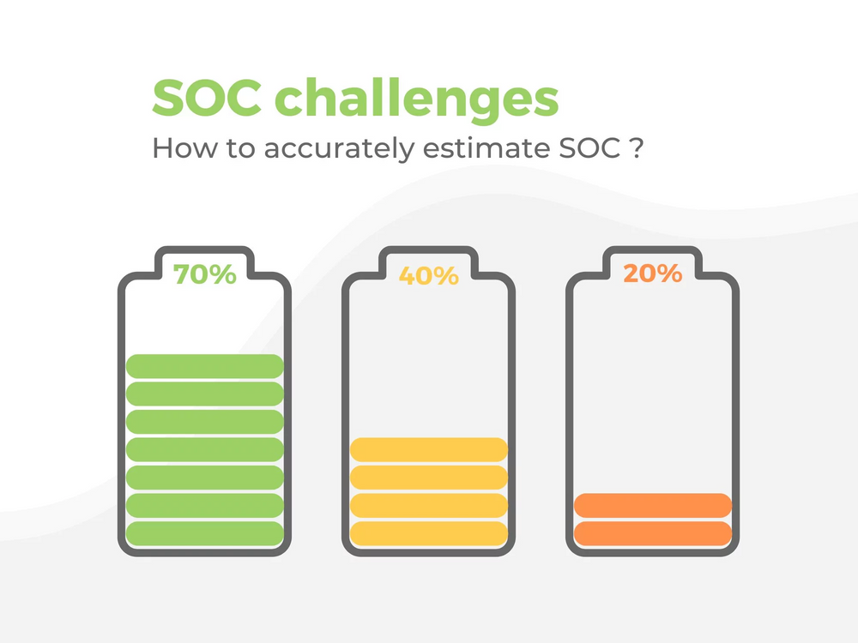
Abstract
Accurate SOC estimation.
Estimation SOC remains a challenge.
In this work, both theory-based methods and advanced approaches based on ML and DL were analized for State of Charge (SOC) estimation.
1
Notes:
Accurate SOC estimation is essential and crucial to improve operation safety and service life of Li-ion batteries.
Estimation SOC remains a challenge, leading to the replacement of traditional theory-based methods with data-driven approaches, enabled by increased battery data and AI advancements.
In this work, both theory-based methods and advanced approaches based on ML and DL were analized for State of Charge (SOC) estimation.

Slide 5
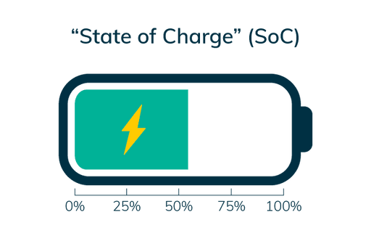
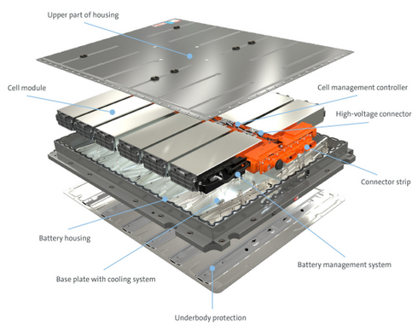
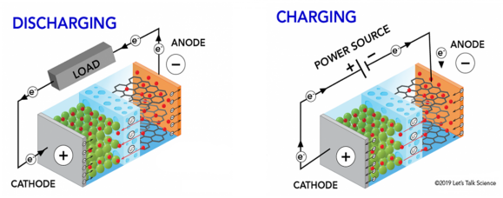
An overview on the main topics
What’s SOC and DOD?
What’s Battery Management System and why is it so important?
Battery pack, modules and cells.
Lithium-ion cells.
Notes:
State of charge (SoC) quantifies the remaining capacity available in a battery at a given time and in relation to a given state of ageing. It is usually expressed as percentage (0% = empty; 100% = full). An alternative form of the same measure is the Depth of Discharge (DoD), calculated as 1 − SoC (100% = empty; 0% = full).
One important subsystem that can be found inside an electric vehicle is the Battery Management System (BMS). It is an embedded system that is designed to properly manage the particular Energy Storage device, which is typically a rechargeable battery, that is adopted as a source of energy for the entire vehicle. The main tasks that the BMS has to perform are:
• continuously monitor the battery by acquiring measures of voltage, current and temperature
• compute parameters that describe the state of the battery like the State of Charge (SoC) and the State of Health (SoH)
• ensure the safety by guaranteeing that every operation performed on the battery lies in the Safe Operation Area (SOA), so by avoiding: over-charge, overdischarge, over-voltage (during charge) and thermal runaway
The battery pack represents the energy storage device of an electric vehicle and is used to stock energy (typically in the form of electrochemical potential) with the purpose of providing it to the vehicle motor and other subsystems. It is managed by the BMS. Modules embed some electronics that help the BMS to monitor the state of the cells by acquiring measures of voltage, current and temperature thanks to the presence of corresponding sensors. In this context the BMS is able to act a control action in order to ensure the safety of the charge/discharge operations performed over the cells and to control the temperature thanks to the presence of a cooling/heating system.
Lithium-ion battery is a particular kind of electrochemical cell that converts electric energy into chemical energy during discharging processs (in this case is called electrolytic cell) and vice versa during charging process (in this case is called galvanic cell). At the simplest abstraction level, the cell is composed by a positive (anode) and negative (chathode) electrodes (active elements) and an electrolyte (passive element). The mechanisms of energy conversion, during charging and discharging processes happen through redox reactions (oxidation and reduction) at the active components. In these circumstances, electrons migrate from one electrode to the other by following an external circuit, while generated ions passes through the electrolyte reaching the other side electrode. The main components of the electrochemical cell from the perspective of a Lithium-ion cell are the following:
• electrodes: Conductive materials that enable electron and ion movement. The anode stores ions and donates electrons (typically made of graphene), while the cathode accepts electrons and stores lithium by combining it with metal oxides like Co, Ni, Fe, Mn.
• electrolytes: A medium (liquid or polymeric) that carries ions between electrodes. It typically consists of salts dissolved in solvents, with high ionic conductivity.
• current collector: A porous material used with liquid electrolytes to prevent electrode contact, thus avoiding short circuits.
• casing: An external enclosure, typically plastic or metallic, that insulates and protects the cell, preventing electrolyte evaporation and ensuring structural integrity. It can be cylindrical or prismatic in shape.

Slide 6
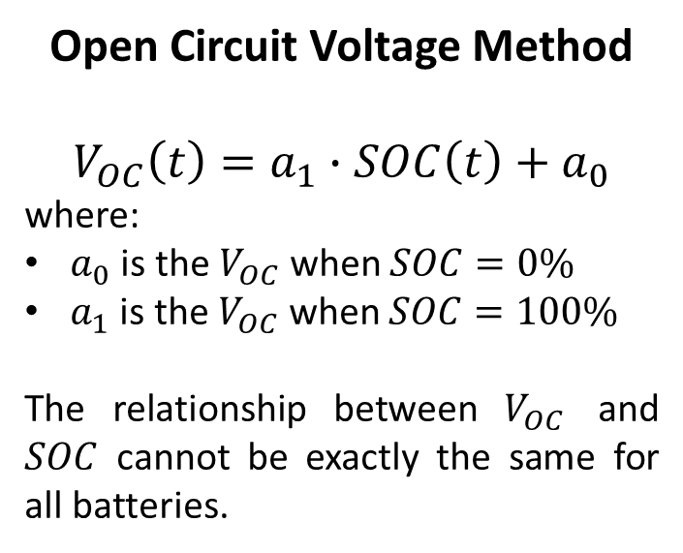
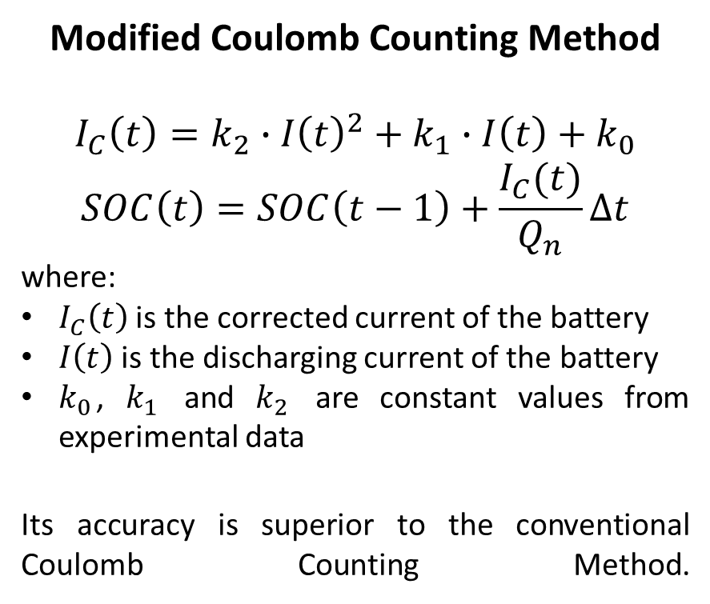
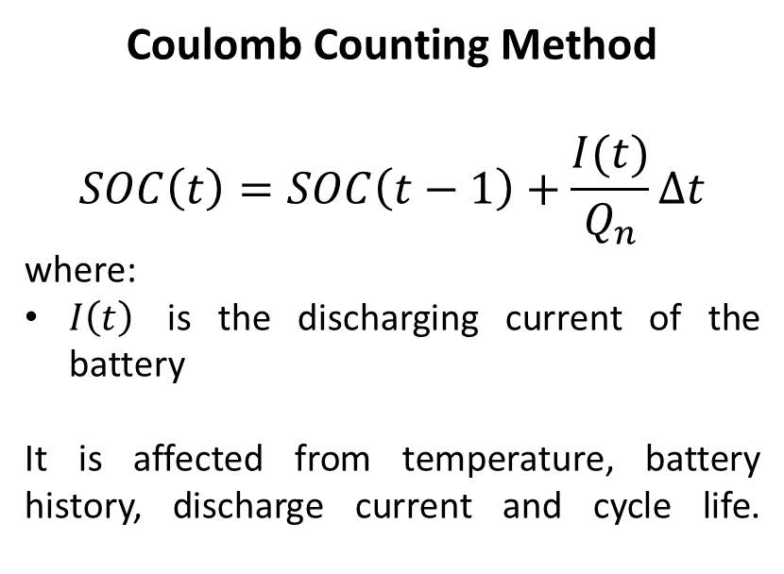
Typical approaches and their drawbacks
Open Circuit Voltage Method
$$V_{OC}\left(t\right)=a_{1}∙SOC\left(t\right)+a_{0}$$
where:
$a_{0}$ is the $V_{OC}$ when $SOC=0\%$
$a_{1}$ is the $V_{OC}$ when $SOC=100\%$
The relationship between $V_{OC}$ and $SOC$ cannot be exactly the same for all batteries.
Coulomb Counting Method
$$SOC\left(t\right)=SOC\left(t−1\right)+\frac{I(t)}{Q_{n}}Δt$$
where:
$I\left(t\right)$ is the discharging current of the battery
It is affected from temperature, battery history, discharge current and cycle life.
Modified Coulomb Counting Method
$$I_{C}\left(t\right)=k_{2}∙I{\left(t\right)}^{2}+k_{1}∙I\left(t\right)+k_{0}$$
$$SOC\left(t\right)=SOC\left(t−1\right)+\frac{I_{C}(t)}{Q_{n}}Δt$$
where:
$I_{C}\left(t\right)$ is the corrected current of the battery
$I\left(t\right)$ is the discharging current of the battery
$k_{0}$, $k_{1}$ and $k_{2}$ are constant values from experimental data
Its accuracy is superior to the conventional Coulomb Counting Method.
Notes:
Open Circuit Voltage Method: SOC(t) is the SOC of the battery at t, a₀ is the battery terminal voltage when SOC = 0%, and a₁ is obtained from knowing the value of a₀ and V_{OC}(t) at SOC = 100%. The OCV method based on the OCV of batteries is proportional to the SOC when they are disconnected from the loads for a period longer than two hours. However, such a long disconnection time may be too long to be implemented for battery. Unlike the lead-acid battery, the Li-ion battery does not have a linear relationship between the OCV and SOC. The relationship between the OCV and SOC cannot be exactly the same for all batteries.
Coulomb Counting Method: The Coulomb counting method measures the discharging current of a battery and integrates the discharging current over time in order to estimate SOC. Coulomb counting method is done to estimate the SOC(t), which is estimated from the discharging current, I(t), and previously estimated SOC values, SOC(t − 1). But there are several factors that affect the accuracy of Coulomb counting method including temperature, battery history, discharge current, and cycle life.
Modified Coulomb Counting Method: To improve the Coulomb counting method, a new technique called modified Coulomb counting method is proposed. The modified Coulomb counting method uses the corrected current to improve the accuracy of estimation. The corrected current is the function of discharging current. There is a quadratic relationship between the corrected current and discharging current of battery. k₂, k₁ and k₀ are constant values obtained from the practice experimental data. The experimental results show that the accuracy of the modified Coulomb counting method is superior to the conventional Coulomb counting method.

Slide 7
Advanced approaches
State of Charge Estimation for Electric Vehicle Battery Management Systems Using the Hybrid Recurrent Learning Approach with Explainable Artificial Intelligence: https://doi.org/10.3390/en15218003
Synthetic Stage of Charge Estimation for Lithium-ion Batteries Based on Long Short-Term Memory Network Modeling and Adaptive H-Infinity Filter: https://doi.org/10.1016/j.energy.2021.120630

Slide 8
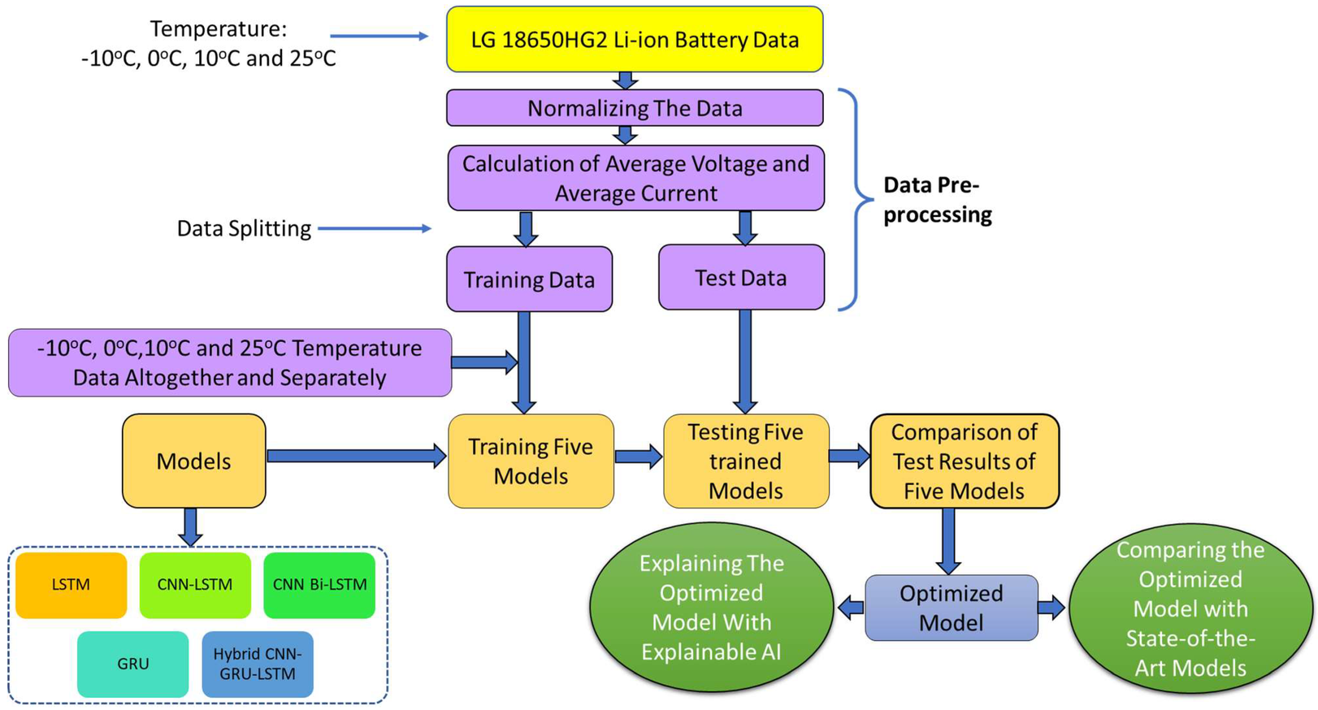
State of Charge Estimation for Electric Vehicle Battery Management Systems Using the Hybrid Recurrent Learning Approach with Explainable Artificial Intelligence
Dataset: https://doi.org/10.17632/cp3473x7xv.3
Notes:
State of Charge Estimation for Electric Vehicle Battery Management Systems Using the Hybrid Recurrent Learning Approach with Explainable Artificial Intelligence: https://doi.org/10.3390/en15218003
Synthetic Stage of Charge Estimation for Lithium-ion Batteries Based on Long Short-Term Memory Network Modeling and Adaptive H-Infinity Filter: https://doi.org/10.1016/j.energy.2021.120630

Slide 9
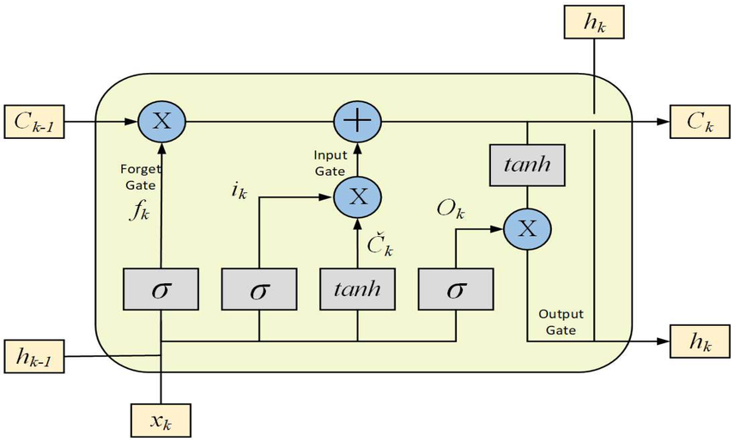
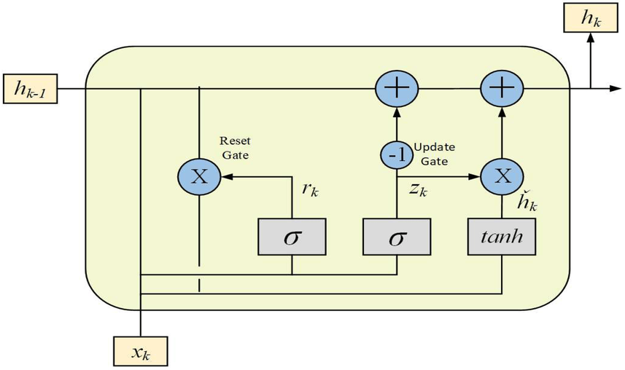
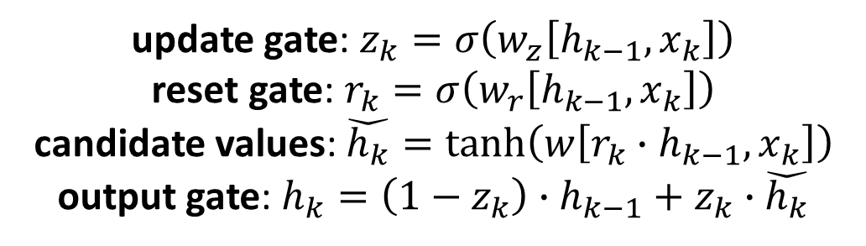
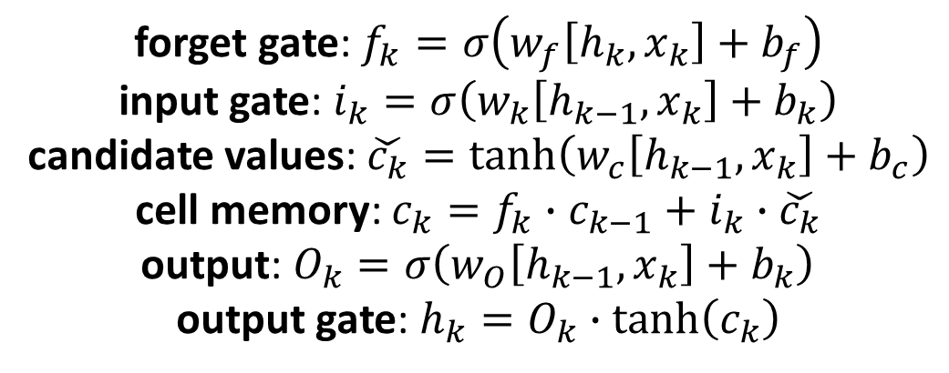
State of Charge Estimation for Electric Vehicle Battery Management Systems Using the Hybrid Recurrent Learning Approach with Explainable Artificial Intelligence
The Long Short-Time Memory Unit is developed to prevent the problem of long-term dependency.
The Gated Recurrent Unit is developed as an updated version of LSTM to counteract the complexity of the latter.
forget gate: $f_{k}=σ\left(w_{f}\left[h_{k},x_{k}\right]+b_{f}\right)$
input gate: $i_{k}=σ\left(w_{k}\left[h_{k−1},x_{k}\right]+b_{k}\right)$
candidate values: $\check{c_{k}}=\tanh\left(w_{c}\left[h_{k−1},x_{k}\right]+b_{c}\right)$
cell memory: $c_{k}=f_{k}∙c_{k−1}+i_{k}∙\check{c_{k}}$
output: $O_{k}=σ\left(w_{O}\left[h_{k−1},x_{k}\right]+b_{k}\right)$
output gate: $h_{k}=O_{k}∙\tanh\left(c_{k}\right)$
update gate: $z_{k}=σ\left(w_{z}\left[h_{k−1},x_{k}\right]\right)$
reset gate: $r_{k}=σ\left(w_{r}\left[h_{k−1},x_{k}\right]\right)$
candidate values: $\check{h_{k}}=\tanh\left(w\left[{r_{k}∙h}_{k−1},x_{k}\right]\right)$
output gate: $h_{k}=\left(1−z_{k}\right)∙h_{k−1}+z_{k}∙\check{h_{k}}$
Notes:
The LSTM is developed to prevent the problem of long-term dependency. It is its default behavior to remember information for long periods of time. $c_{k}$ is denoted as the cell memory where $k$ is denoted as time. The LSTM has 3 gates: forget, input and output. The forget gate $f_{k}$ decides which information has to be erased from the cell memory. Mainly the sigmoid function decides whether the information in $c_{k−1}$ has to be erased or not. $w_{f}$ are weights metrics, $h_{k−1}$ is the previous layer hidden state layer, $x_{k}$ the is input vector and $b_{f}$ are the bias of the network. $i_{k}$ is the input gate and it keeps the new information in the unit memory $c_{k}$. Specifically, in the input gate there is a sigmoid layer to choose which value should be updated first. The tanh layer generates the $\check{c_{k}}$ vector of the new candidate values that could be added to the state. Combining $f_{k}$, $i_{k}$ and $\check{c_{k}}$ equations, it is possible to update unit memory $c_{k}$. In particular, the output is provided by $O_{k}$, which is used to perform the task related to which part of the unit memory will be used, and by $h_{k}$ where $O_{k}$ is multiplied with a tanh function which makes values from -1 to 1.
The GRU is developed as an updated version of LSTM to reduce complexity and to work even with small datasets. Specifically, this unit introduce the reset gate and the update gate. The reset gate $r_{k}$ controls how to integrate a new input with prior inputs in its memory, while the update gate $z_{k}$ specifies how much of the previous memory should be retained.

Slide 10
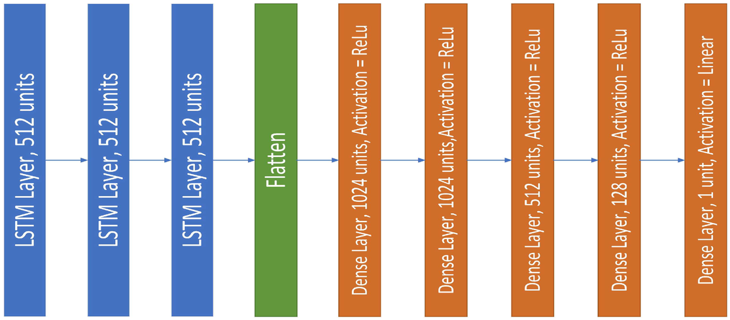
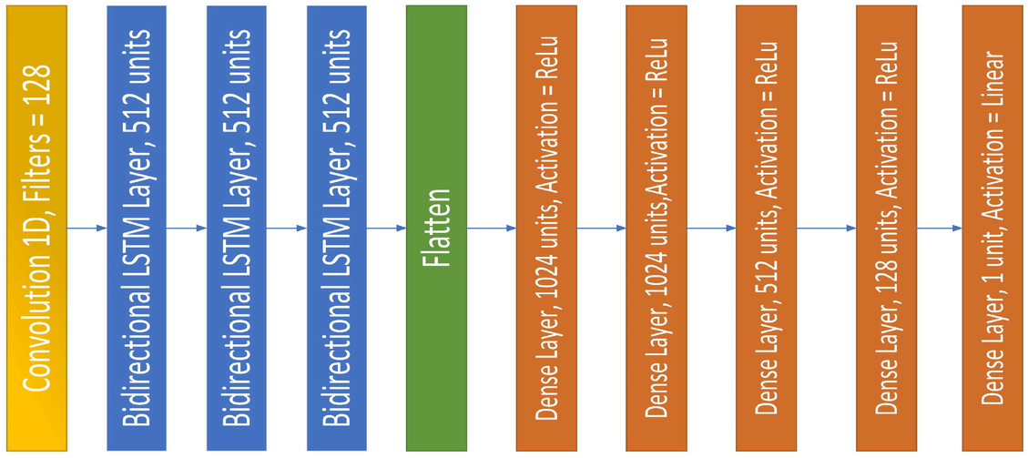
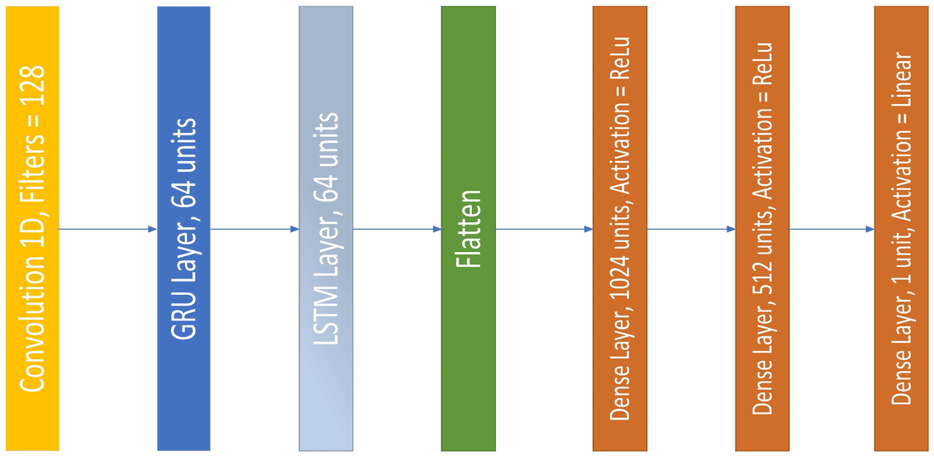
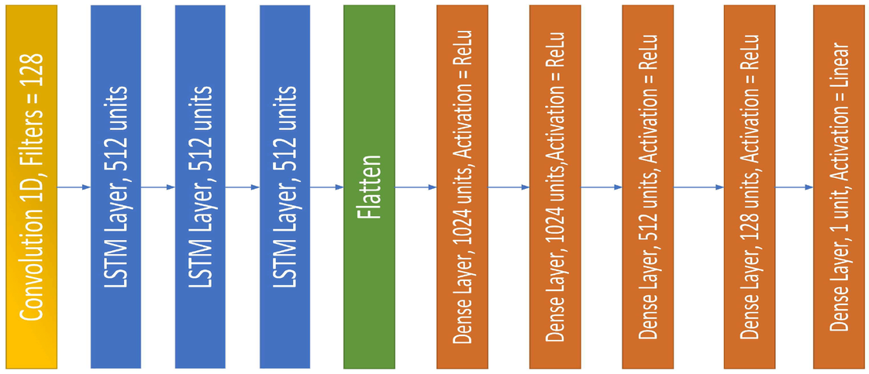
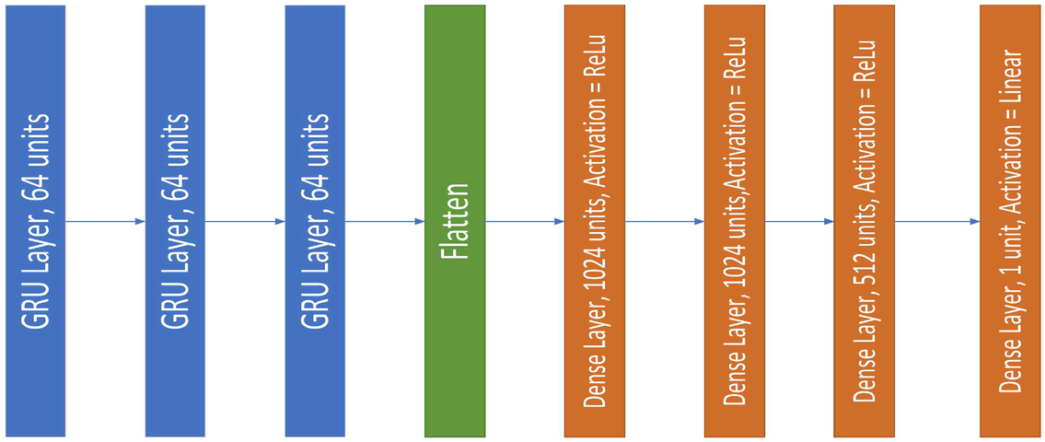
State of Charge Estimation for Electric Vehicle Battery Management Systems Using the Hybrid Recurrent Learning Approach with Explainable Artificial Intelligence
LSTM
no_params: 9,513,729
CNN-LSTM
no_params: 9,774,849
CNN-Bi-Directional LSTM
no_params: 22,101,761
GRU
no_params: 1,729,217
Hybrid CNN-GRU-LSTM
no_params: 925,313
Notes:
LSTM: LSTM is used because of its unique ability to disingenuously recognize sequences over extended periods of time.
CNN-LSTM: CNN is used for the extraction of features on the input data and merged then with the LSTMs.
CNN-Bi-Directional LSTM: A Bi-Directional LSTM is a sequential computational framework that consists of 2 LSTM, one of which receives the input in forward time order and the other receives the input in backward time order. The other parts of architecture are the same of the previous.
GRU: GRU is used because of a less number of gates (than LSTM) and so for its less complexity (than LSTM).
Hybrid CNN-GRU-LSTM: Hybrid model is important to include the prevention from long-term dependency of LSTM, the feature extraction of CNN and the less complexity of GRU.

Slide 11
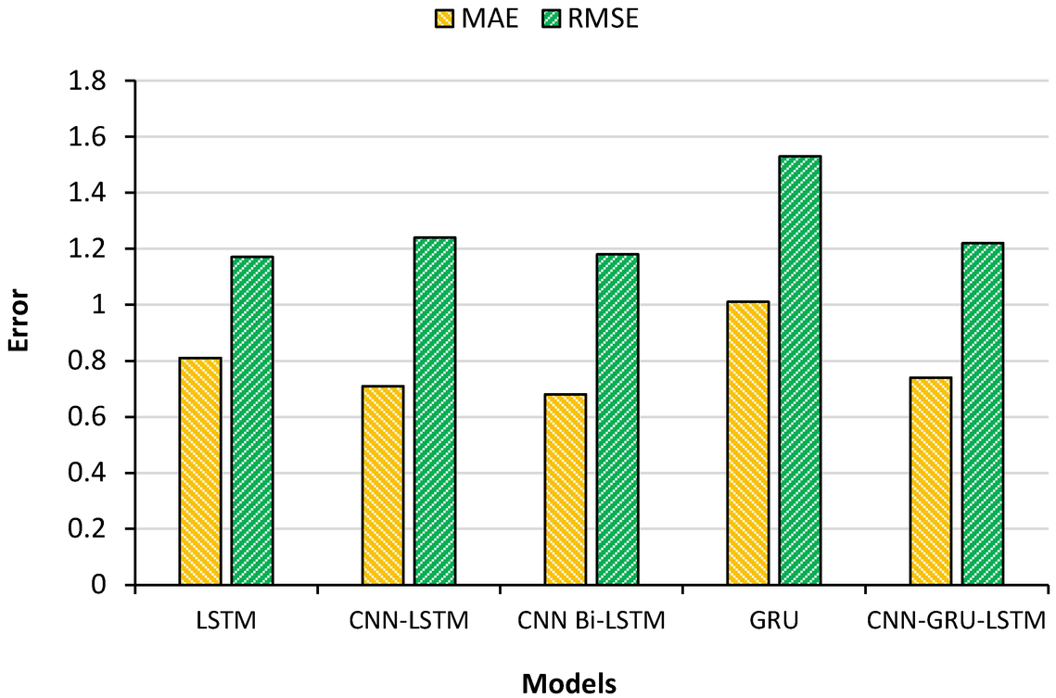
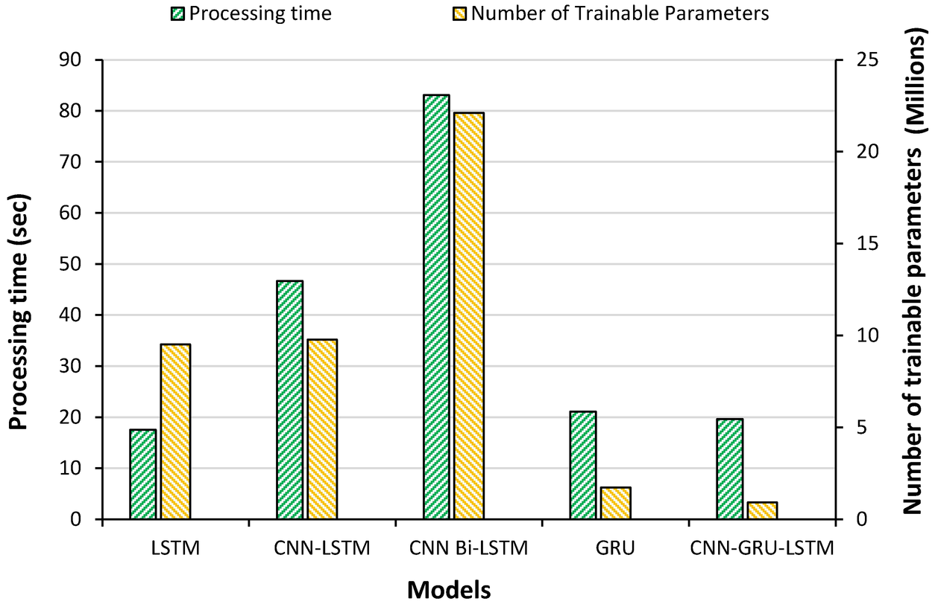
State of Charge Estimation for Electric Vehicle Battery Management Systems Using the Hybrid Recurrent Learning Approach with Explainable Artificial Intelligence
The CNN Bi-LSTM model provided the most accurate SOC predictions but had the highest prediction time and number of trainable parameters. In contrast, the Hybrid CNN-GRU-LSTM model achieved similar accuracy to CNN-LSTM but with fewer trainable parameters and less prediction time, making it the optimal model among the five tested.

Slide 12
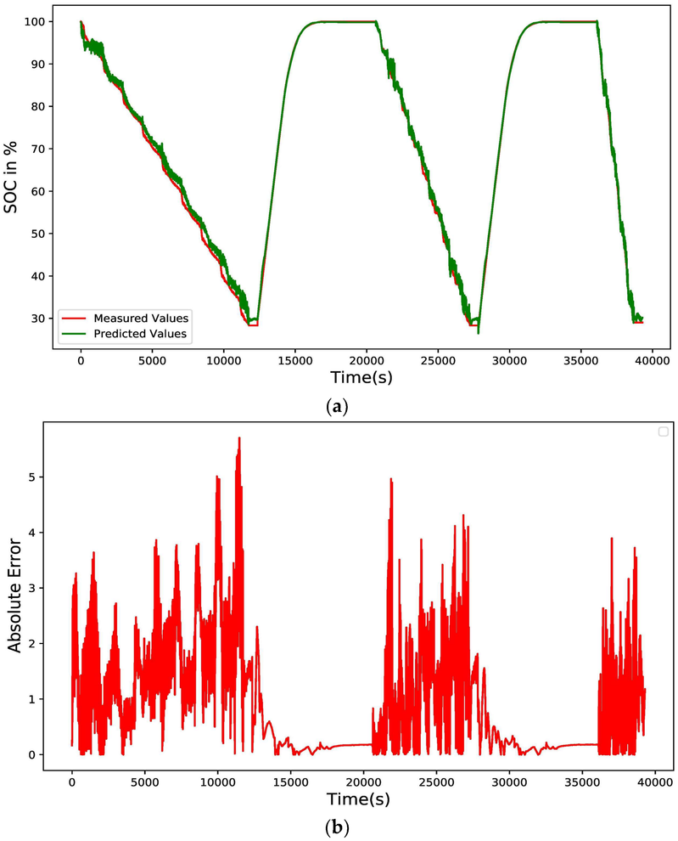
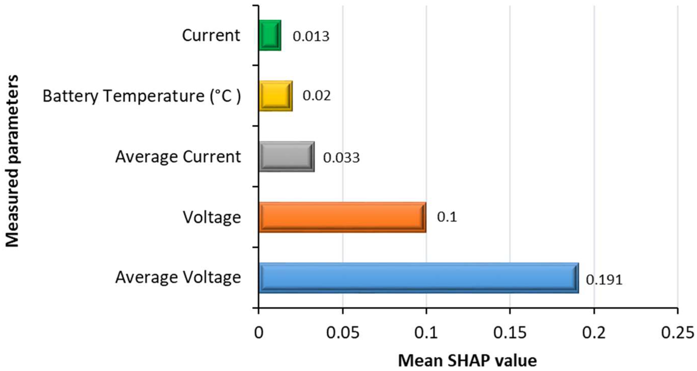
State of Charge Estimation for Electric Vehicle Battery Management Systems Using the Hybrid Recurrent Learning Approach with Explainable Artificial Intelligence
Considering the Hybrid CNN-GRU-LSTM model…
Notes:
At first, the model that was trained with the data altogether, was tested with SHAP, which revealed that, from the five inputs, the average voltage was the most important input feature. The prediction of the SOC depends on the average voltage the most and on the nonlinear behavior of the battery voltage. Since the average voltage is the average of the voltages (the present voltage and the previous voltage values) of a moving window, which is a statistical method to quickly identify the changes in the residual mean value and standard deviation, it contains a lot of information on the previous condition of the SOC. It is the main requirement of the RNN, that the previous important input and output, should be considered for the present output. Following the average voltage, the present voltage is another important input feature. As the average voltage contains information about the previous and present states altogether, the instantaneous voltage information is also an important feature for the SOC estimation. Furthermore, the average current containing the information on the present and previous loads on the battery, is also important information for the SOC estimation. As the battery behavior changes with the ambient temperature, its importance is shown in the SHAP chart. The instantaneous current was shown to be a less important feature, as its impact was very low in the SOC estimation.

Slide 13
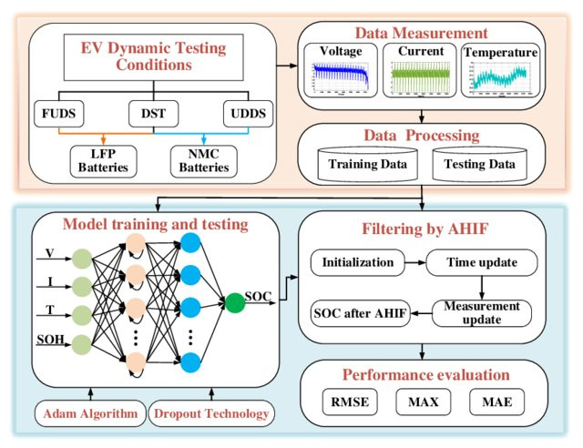
Synthetic Stage of Charge Estimation for Lithium-ion Batteries Based on Long Short-Term Memory Network Modeling and Adaptive H-Infinity Filter
Dataset: Federal urban driving schedule (FUDS) and dynamic stress test (DST) under different temperatures (from -10°C to 50°C with 10 °C as an increase interval)
Notes:
The whole process is divided into 4 parts:
Data Measurement: the dynamic data are acquired
Data Processing: the data are processed and divided into 2 categories
Model Training and Testing: LSTM is applied and then the trained model is applied to predict the rough SOC
Filtering: the main task of AHIF is to eliminate the noise in the LSTM and renovate the SOC. In particular, this filter is used to make smoother the predicted estimation results from the neural networks. Specifically, HIF is developed to cope with model uncertainty and externalo disturbance uncertainty of the system. However, in HIF algorithms, it is assumed that the process and measurement noise covariance are costant. During SOC estimation, the noise covariance may vary with battery internal and surrounding operation conditions instead. Thus, to improve the performance of LSTM network, AHIF is employed thanks to its noise covariance that change dynamically. The recursive calculation procedure of AHIF is detailed as follows:
Initialization: set the initial value (of state variable, of the system noise covariance and of the measurement noise covariance) and calculate the initial mean and covariance.
Time update: calculate the prior estimate of state, calculate the prior estimate of error covariance, calculate the symmetric positive definite matrix update.
Measurement update: condition judgement, innovation update, adaptive estimation of measurement noise matrix calculation, gain matrix update, adaptive estimation of system noise matrix calculation, measurement update of state estimate and measurement update of error covariance.
The battery capacity highly depends on environment temperature and aging state.
For easier calculation, a five-order polynomial equation is employed to fit the relationship between the maximum discharge capacity and temperature, and the measured and fitted result.
$$Q_{n}\left(t\right)=2.667×{10}^{−9}T^{5}−4.258×{10}^{−7}T^{4}+2.555×{10}^{−5}T^{3}−0.00094T^{2}+0.03448T+3.34011$$
The maximum discharge capacity [Ah] is the maximum quantity of energy that could be released from battery during discharge cycle. Specifically, the maximum discharge capacity at different temperature is obtained by the calibration test.
For easier calculation, it is assumed that the capacity of the aged battery is known in advance due to the enabling SOH prediction techniques.

Slide 14
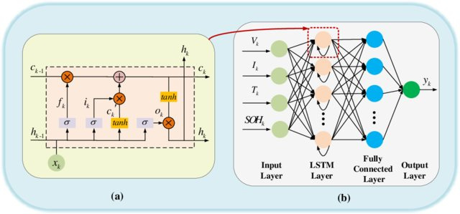
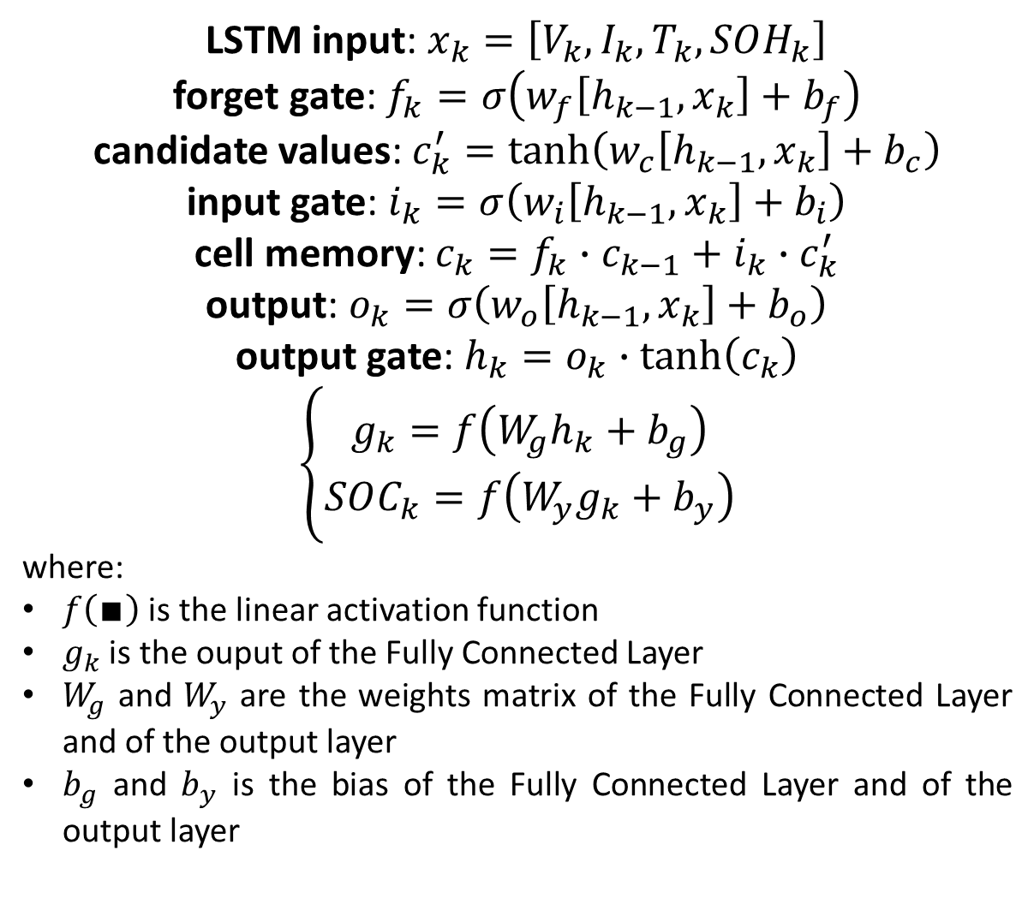
Synthetic Stage of Charge Estimation for Lithium-ion Batteries Based on Long Short-Term Memory Network Modeling and Adaptive H-Infinity Filter
LSTM input: $x_{k}=\left[V_{k}, I_{k},T_{k},SOH_{k}\right]$
forget gate: $f_{k}=σ\left(w_{f}\left[h_{k−1},x_{k}\right]+b_{f}\right)$
candidate values: $c_{k}^{′}=\tanh\left(w_{c}\left[h_{k−1},x_{k}\right]+b_{c}\right)$
input gate: $i_{k}=σ\left(w_{i}\left[h_{k−1},x_{k}\right]+b_{i}\right)$
cell memory: $c_{k}=f_{k}∙c_{k−1}+i_{k}∙c_{k}^{′}$
output: $o_{k}=σ\left(w_{o}\left[h_{k−1},x_{k}\right]+b_{o}\right)$
output gate: $h_{k}=o_{k}∙\tanh\left(c_{k}\right)$
$$\left\{\begin{aligned}g_{k}=f\left(W_{g}h_{k}+b_{g}\right) \\ SOC_{k}=f\left(W_{y}g_{k}+b_{y}\right)\end{aligned}\right.$$
where:
$f\left(∎\right)$ is the linear activation function
$g_{k}$ is the ouput of the Fully Connected Layer
$W_{g}$ and $W_{y}$ are the weights matrix of the Fully Connected Layer and of the output layer
$b_{g}$ and $b_{y}$ is the bias of the Fully Connected Layer and of the output layer
Notes:
$x_{k}$ and $h_{k}$ denote input and output of the LSTM unit at time k
$f_{k}$, $i_{k}$, $c_{k}$ and $o_{k}$ represent the forget gate, input gate, memory cell and output gate, respectively
$w$ and $b$ indicate the weight matrix and bias parameters to be learned during the training process
$c_{k}^{′}$ is the intermediate variable
$σ\left(∎\right)$ and $tanh(∎)$ are the sigmoid and hyperbolic tangent activation functions. The output value of the sigmoid activation function is restricted within 0 and 1 while the output value of the hyperbolic tangent activation function is located between -1 and 1.
The influence of dynamic operation conditions, temperature and capacity degradation on SOC estimation are fully taken into consideration. The model input $x_{k}$ includes voltage, current, temperature and SOH.
The estimated $SOC_{k}$ are obtained through:
$g_{k}$ that represents the output oof the full connection layer.
$f\left(∎\right)$ that represents the linear activation function (linear activation function is preferable than non-linear activation function because of its less complexity and more learning speed).
$V_{g}$ that represents the weights matrix of the fully connected layer.
$b_{g}$ that represents the bias parameters of the fully connected layer.
$V_{y}$ that represents the weights matrix of the output layer.
$b_{y}$ that represents the bias parameters of the output layer.

Slide 15
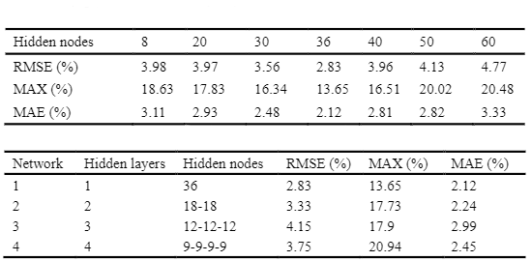
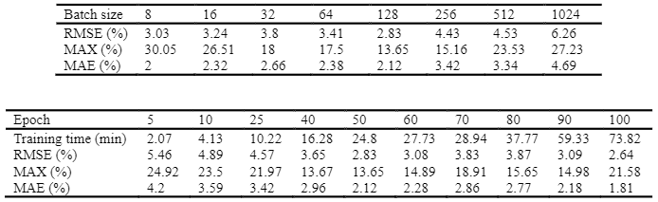
Synthetic Stage of Charge Estimation for Lithium-ion Batteries Based on Long Short-Term Memory Network Modeling and Adaptive H-Infinity Filter
About Hyper-Parameter selection…
Hidden nodes
Hidden LSTM layers
Batch size
Training epochs

Slide 16
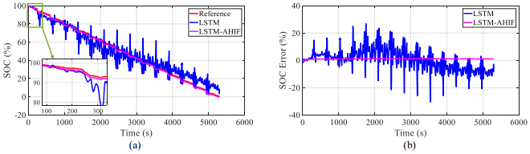
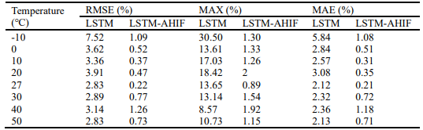
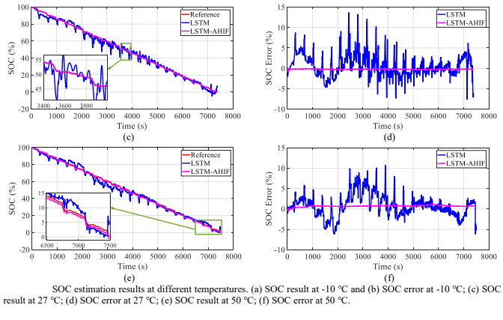
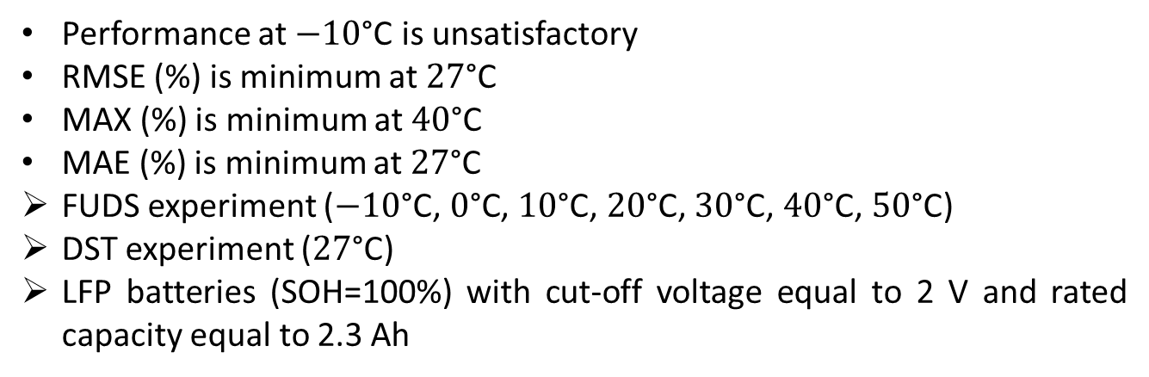
Synthetic Stage of Charge Estimation for Lithium-ion Batteries Based on Long Short-Term Memory Network Modeling and Adaptive H-Infinity Filter
About SOC estimation at different temperature…
Performance at $−10\text{°}\text{C}$ is unsatisfactory
RMSE (%) is minimum at $27\text{°}\text{C}$
MAX (%) is minimum at $40\text{°}\text{C}$
MAE (%) is minimum at $27\text{°}\text{C}$
FUDS experiment ($−10\text{°}\text{C}$, $0\text{°}\text{C}$, $10\text{°}\text{C}$, $2\text{0}\text{°}\text{C}$, $30\text{°}\text{C}$, $40\text{°}\text{C}$, $50\text{°}\text{C}$)
DST experiment ($27\text{°}\text{C}$)
LFP batteries (SOH=100%) with cut-off voltage equal to 2 V and rated capacity equal to 2.3 Ah
Notes:
LSTM method at $−10\text{°}\text{C}$ is unsatisfactory because of sharp increase of polarization when the battery works at low temperatures.
The MAX is higher than $10\text{\%}$ in most cases indicating that the results are not stable and fluctuate dramatically.
Large estimation deviation emerges when SOC varies in the range of 30% to 80%.

Slide 17
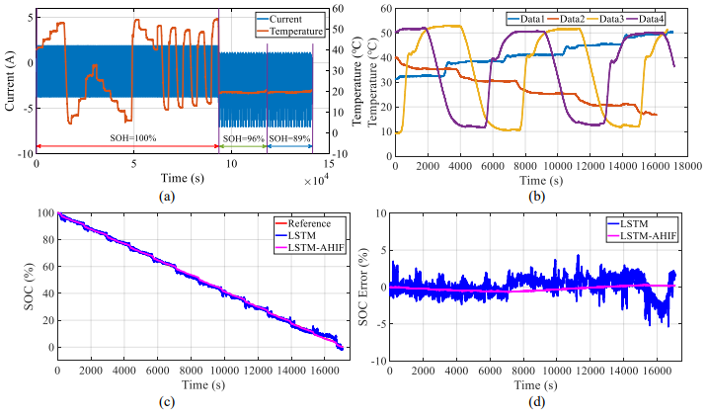
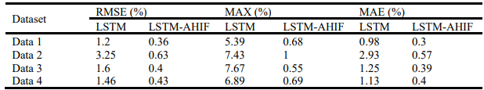
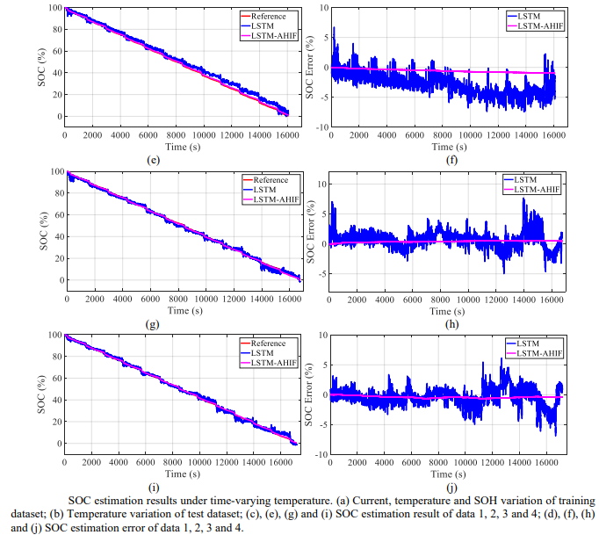
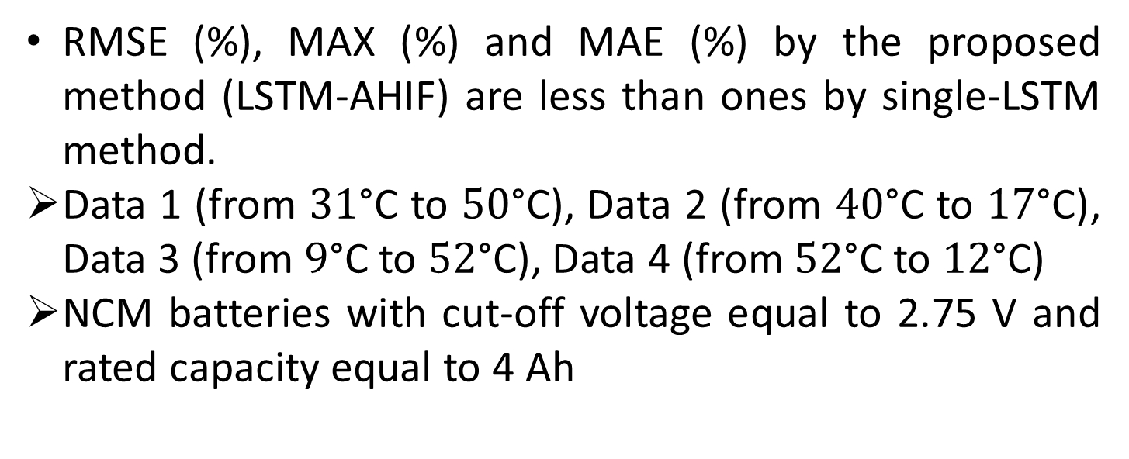
Synthetic Stage of Charge Estimation for Lithium-ion Batteries Based on Long Short-Term Memory Network Modeling and Adaptive H-Infinity Filter
About SOC estimation under dynamic time-varying temperature conditions…
RMSE (%), MAX (%) and MAE (%) by the proposed method (LSTM-AHIF) are less than ones by single-LSTM method.
Data 1 (from $31\text{°}\text{C}$ to $50\text{°}\text{C}$), Data 2 (from $40\text{°}\text{C}$ to $17\text{°}\text{C}$), Data 3 (from $9\text{°}\text{C}$ to $52\text{°}\text{C}$), Data 4 (from $52\text{°}\text{C}$ to $12\text{°}\text{C}$)
NCM batteries with cut-off voltage equal to 2.75 V and rated capacity equal to 4 Ah
Notes:
It can be found that the RMSE (%), MAX (%) and MAE (%) by the single-LSTM method are, respectivly, within 3.25%, 7.67% and 2.93% while ones by LSTM-AHIF are 0.635, 0.55% and 0.57% indicating that the proposed method highlights strong robustness against different battery types and superior estimation accuracy under dynamic time-varying temperature conditions.
Moreover, considering aged test data, i.e. batteries with SOH values equal to 87%, it is possible to conclude that single-LSTM cannot predict the SOC accurately when the battery is aged. The proposed method (LSTM-AHIF), instead, achieves quite low errors. Therefore, these results clearly manifest the effectiveness of the proposed method even in the aged batteries.

Slide 18
SOC Estimation Using the Feed-Forward Learning Approach and Machine Learning Techniques with Explainable Artificial Intelligence
You can find the full dataset at the following link:
https://doi.org/10.17632/cp3473x7xv.3
You can find the full project repository on GitHub at the following link:
https://github.com/sayandeep02/State-of-Charge-SOC-Estimation-Using-Machine-Learning
1

Slide 19
Thanks.

